Slide 1
Demystifying Apprenticeship
December 12, 2019
Notes:
Sarah Stocker: Welcome everyone. We are here to enjoy another in our series of Pop Up PD webinars. It’s my pleasure to introduce our webinar moderator today, Deb Flynn, Executive Director of the QUILL Learning Network. Over to you, Deb.

Slide 2
About Pop Up PD for Literacy Educators
free webinar series developed by Ontario’s LBS Regional Networks, Sectors, & the Provincial Support Organizations for Literacy
supports LBS practitioners with presentations on topics important to them
webinars presented for LBS practitioners annually since 2015-2016; French language transcriptions coming soon!
all webinar presentations, recording links & transcripts here:
https://e-channel.ca/practitioners/pop-pd-resources
webinar topic ideas welcome at: e-channel@contactnorth.ca
Notes:
Debera Flynn: Thank you very much, Sarah. It’s lovely to be here with everyone today. Today’s webinar is, as you know, part of a free webinar series that has been developed by the Regional Networks, the Sectors and Streams, and the Provincial Support Organizations for literacy. We did this so that we could bring you at-your-desk training, because we know how much professional development costs. There are a lot of things going on in our field that are new to us and new to you, and we want to ensure that you can build your organizational capacity to be able to deal with them.
We’ve been presenting these webinars since 2015-16, and we do have some French translations. In fact, the first webinar of this year has been translated into French and is being uploaded to the E-Channel site for any of our Francophone colleagues who would like to listen to it. All of the webinars are transcribed so that we can assist anyone in reading some of the material if they choose to want to read through it and gather any information that way. It’s all held at the link posted on the slide.
If you have any ideas for topics that you would like us to do a webinar on, because we are currently in the midst of business planning and we are getting ready for next year’s series, you can always email me at execdir.quill@quillnetwork.ca or use the email you see on the screen.

Slide 3
Important Meaningful Work the World Can See
Notes:
Now I would like to introduce our facilitator for today’s workshop on demystifying apprenticeship. It’s definitely a topic we want to know more about, and it’s changing daily. Barb Glass will be presenting today. Barb started her teaching career at the then York Region Board of Education. In 1990, she relocated to North Bay and spent 23 years at Canadore College. She taught and coordinated the Adult Upgrading and Pre-Apprenticeship programs at the college. Then she moved to Conestoga College. She was the Chair of the Preparatory Programs there and then did a three year tenure at Niagara College as the Associate Dean for Access Programs. In 2016, Barb began her current position as Executive Director of the College Sector Committee for Adult Upgrading. Barb has been very involved in our field for many years, and even though she was working at Conestoga and Canadore, she was often working on projects for the College Sector Committee. I’d like to welcome Barb today, and I look forward to her presentation.
Barb Glass: Thank you for the introduction! I’m very happy to be able to talk with you today, exchange some information and hopefully answer some questions you might have about apprenticeship. There is, I have to say, a significant irony in the title of the webinar, Demystifying Apprenticeship, because here in Ontario we are in the midst of significant apprenticeship reform.

Slide 4
A Few Words About Today’s Session…
Since late 2018, the Ontario government has been committed to modernizing and reforming apprenticeship training in Ontario.
This webinar focuses on general information about apprenticeship that is of interest to adult learners and educators.
At the time of this webinar, apprenticeship reform in Ontario is ongoing, so it will be important to watch for updates or changes in the near future.
Notes:
I will just highlight a few comments about apprenticeship reform before we get into the presentation. Just over a year ago, the Government of Ontario issued some information regarding a number of ways in which they were planning to modernize and reform apprenticeship in Ontario. As of yet, some of those changes have come to fruition, but most of them haven’t. They are still on the discussion table; they aren’t policy yet. My best advice is to stay tuned and look for more information as it comes out about some of the ways in which apprenticeship reform is going to happen in Ontario.
What I can say, and what the Ministry asked me to highlight (I spoke to them briefly before this presentation) was that we should all be aware that the Ontario College of Trades, which has been the regulatory body for the skilled trades for the last number of years is being would down. Right now, the Ontario College of Trades website is still active, and I will be referencing it in today’s presentation, but with the caveat that it won’t be there for a lot longer. The Ministry is currently looking at how to reassign the regulatory duties of the College of Trades. It is analogous to the Ontario College of Nurses or the Ontario College of Dental Hygienists or any professional regulatory body. The Ontario government has decided to have another look at how to regulate the trades in Ontario including apprenticeship. Best case scenario? Stay tuned for more information.
There is information in today’s presentation that may change in the coming months or the next year, but what I am really trying to focus on is more the person, i.e., what does an apprentice do? How do they become an apprentice? I hope that regardless of the fact that some of the information might change in the future, it will give you a good idea of what apprenticeship in Ontario looks like right now.
I am happy to take questions during the presentation if you want to type them into the chat, but we will also have time at the end for a Q&A. If you do ask a question during the presentation, I will try to address it, but if I’m about to talk about it in a slide or two, I might ask you to hold the thought for a bit.
About half-way through, I have a short video that I think you will find interesting.

Slide 5
Some Topics to Demystify and Questions to Answer
What is apprenticeship training
…and what is it not?
What occupations offer apprenticeship training?
What are the academic requirements to apply for an apprenticeship?
What financial help is available to apprentices?
What are the steps to follow to obtain an apprenticeship?
What’s involved in the
in-school training component?
What are some important terms to be familiar with?
Is there any help available to find an employer/sponsor?
Notes:
In an effort to “demystify apprenticeship”, I will give you an outline of some of the questions that we can address today. I have tried to start at the beginning, with the assumption that if you are listening to this webinar, you may not have a lot of information about apprenticeship.
First, we’ll look at what apprenticeship is and what it is not, then we’ll look at what kind of occupations offer apprenticeship training, what academic requirements you need to apply for an apprenticeship, the steps in obtaining an apprenticeship, whether you can get any help to find an apprenticeship employer, some of the terminology, what’s involved in the in-school training, and if there is any financial help available to apprentices.
So if this is the kind of information you are looking for, stay tuned, and we’ll be addressing these things today.

Slide 6
Some terms to clarify…
Apprentice –
An individual who is learning a trade and has a formal training contract with a sponsor (employer)
Employer/Sponsor –
The employer hires (sponsors) the apprentice and signs a Registered Training Agreement with the Ministry of Labour, Training, and Skills Development and the apprentice
Journeyperson –
An individual who is fully certified in the trade, can perform work without supervision, and can train apprentices
Training Delivery Agent (TDA) –
An approved deliverer of in-school apprenticeship training
Ontario College of Trades (OCoT) –
The [former] regulatory body for skilled trades and apprenticeship in Ontario; wind-down in progress
Notes:
Just to start off, as all of us as teachers would know, we want to make sure we have a similar vocabulary as a starting point in our discussion today. I’ll briefly go over a few terms that will come up a number of times today.
An apprentice is somebody who is learning a trade but has a formal training contract with an employer. The employer, also referred to as a sponsor, is the hiring agent, and they sign a contract with the apprentice as well as with the Ministry of Labour, Training and Skills Development. It’s a three-way agreement.
A journeyperson is a person who is fully certified in the trade. They can perform the work without supervision and can train apprentices.
We’ll talk a bit later about TDAs – Training Delivery Agents – is a Ministry-approved deliverer of in-school apprenticeship training. For example, all of the public colleges in Ontario are TDAs, many trade unions are TDAs, and there are some for-profit organizations too.
We’ve also spoken about OCoT, the Ontario College of Trades. You can see I put “former” in square brackets because even though they are still active, they are being phased out.

Slide 7
Apprenticeship training is…
A work-based training program that provides access to well-paying jobs that require a high level of skill, judgement and creativity
A postsecondary education pathway leading to many high-demand occupations
A combination of on-the-job training (about 90% ) and classroom training (about 10% )
A salary-paying job while you are learning, where wages increase with skill level:
‘earn while you learn’
Notes:
In four bullet points, here is what apprenticeship training is.
A work-based training program that provides access to well-paying jobs. Some people think that an apprentice isn’t headed for a lucrative career, but in many cases they are. Also, apprenticeships lead to careers that require a high level of judgment, creativity and skill.
Apprenticeship is one of the three post-secondary education pathways. It is considered a post-secondary pathway.
What you are probably aware of is the third bullet: when you are an apprentice, you are doing a combination of on-the-job training which occupies 85-90% of your time, along with the classroom-based theory training. It’s the TDAs who deliver that in-class training.
If you are an apprentice, the big bonus is that you are earning a salary. As you work through the levels of apprenticeship, your salary increases. When you get your certification and become a journeyperson, then generally your salary increases again.

Slide 8
Apprenticeship training is NOT…
A short cut to getting an education and a career
Just for people interested in traditional skilled trades
Only for people of a certain age or gender
Notes:
I also thought it was important to include some information about what apprenticeship isn’t, to dispel some myths or demystify some things that people think about apprenticeship.
Apprenticeship is in no way a short cut. It is a post-secondary pathway, and as you will see in a few minutes, it takes anywhere from two to five years to complete an apprenticeship. In the past, the connotation around apprenticeship has been around more traditional skilled trades, but as you will also see in a few minutes, there are many occupations outside of what you might consider skilled trades for which one can train. And certainly apprenticeship is not only for young people or just for males or for people of any particular background. There are so many types of apprenticeship programs available. There is really no one-size-fits-all description of who could or could not be an apprentice.

Slide 9
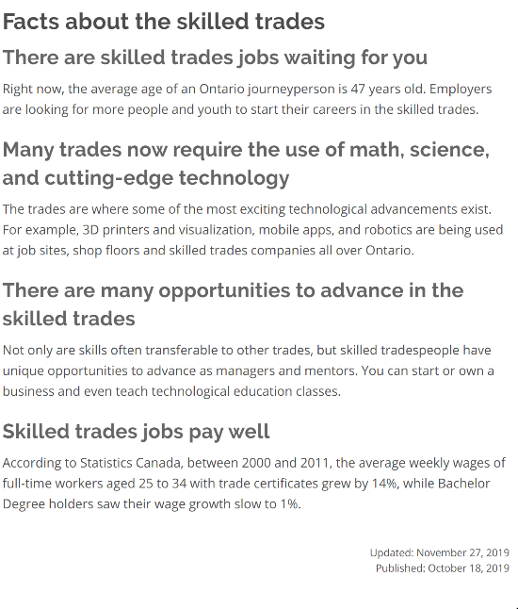
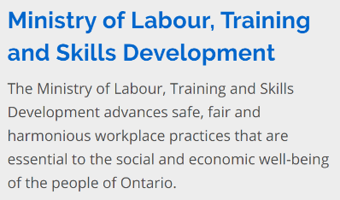
Source: https://www.ontario.ca/page/list-skilled-trades-ontario
Notes:
A few times in the presentation, I will be referencing the website that you see in the bottom right corner. It’s a very good website. Later on, I’ll be referencing a page that’s called “Starting an Apprenticeship”. It’s all part of the same site, and although I won’t link there, you will be able to access it from the presentation.
Part of the website is informational to convey information to educators, apprentices and the general public about apprenticeships that are available and what they entail. Some of it is promotional. Here is an example of some excerpts from the fact page. As you have heard in the media, a lot of skilled trades workers in the province are getting close to retirement age, which is creating an ongoing shortage of skilled workers. This quotes a stat stating that the average age of a journeyperson is 47.
We have a comment that once an apprentice goes through all of the training and passes all of the associated exams, then they are called a journeyperson and can train other apprentices, which is absolutely correct.
There is another comment that this is a nice resource, which it is. I think the Ministry has done a good job of updating their apprenticeship information.
There is another point that many trades now require the use of math, science and cutting edge technology – it’s not just about hammers and nails. There are many opportunities to advance in the trades, and the skilled trades jobs do pay better than many people think. I won’t spend too much time on these screenshots, but I did want to highlight them for you.
I do have a question asking if you have to be a Red Seal to be a journeyperson. No, you don’t, and we will talk a bit about that later.

Slide 10
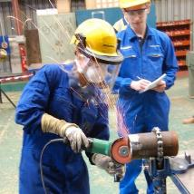
Which occupations/trades offer apprenticeship training?
In Ontario, there are over 140 occupations for which you can train as an apprentice.
Those occupations are organized into four categories called ‘sectors’.
Construction
Industrial
Motive Power
Service
Notes:
In Ontario, there are over 140 occupations for which you can train as an apprentice, which is many more than people think. Apprenticeships in Ontario are organized into four sectors: construction, industrial, motive power, and service. I’m going to show you a list of a few trades that are available in each of those sectors to set the context of some of the apprenticeship opportunities that are available.

Slide 11
A few occupations within each sector
Construction (over 40 occupations) Floor Covering Installer Hazardous Materials Worker Construction Millwright General Carpenter Powerline Technician Electrician – Construction and Maintenance | Industrial (over 50 occupations) Entertainment Industry Power Technician Ski Lift Mechanic Locksmith Welder General Machinist Industrial Electrician
Notes:
The construction sector contains over 40 occupations. Here are some that you are probably familiar with, but I also tried to include some that might be less familiar. For example, you would probably expect to see general carpenter and electrician in the list, but there are a number of construction trades that you might not necessarily associate with apprenticeship such as a floor covering installer, hazardous materials worker or a powerline technician.
Industrial is the largest sector with over 50 occupations. Again, I’ve tried to list some of the less familiar occupations such as the entertainment industry power technician, a ski life mechanic – who knew!, locksmith, and then there are ones that you are probably more familiar with such as a welder and a general machinist.

Slide 12
A few occupations within each sector
Service (almost 40 occupations) Chef Child and Youth Worker Hairstylist Information Technology – Hardware Technician Pool, Hot Tub, and Spa Installer Educational Assistant | Motive Power (almost 20 occupations) Turf Equipment Technician Autobody Repairer Tire, Wheel, and Rim Mechanic Marine Engine Technician Automotive Service Technician Truck and Coach Technician
Notes:
When it comes to the other two sectors, the service sector has close to 40 occupations. Chef is one, but you might not think about child and youth worker. I didn’t know there was a pool, hot tub and spa installer. Hairstylist is probably one you would be familiar with. In information technology, there are a number of different categories of apprenticeships. What’s interesting about IT apprenticeships is that, not surprisingly, most of the in-school training is done online.
Last but not least is motive power. It’s a smaller sector. Turf equipment technician, autobody repair, marine engine technician, etc. What I think is interesting about the first three in this list is that they are associated with auto mechanics or motive power, but they aren’t just being a car mechanic, which is what being an automotive service technician is. There are lots of related occupations in the motive power sector.

Slide 13
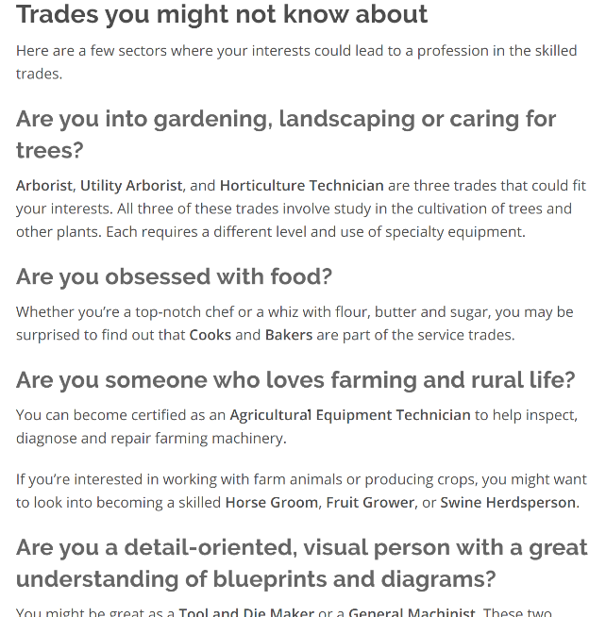
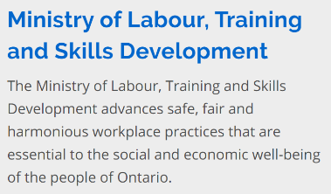
Source: https://www.ontario.ca/page/list-skilled-trades-ontario
Notes:
Here’s another screenshot from the same website. Again, in the spirit of trying to help people learn more about the skilled trades, there is a page of trades you might not know about. I like the way they have framed this for people who might be looking at it, i.e., are you interested in gardening, landscaping or caring for trees? Are you obsessed with trees? Are you someone who loves farming and rural life? It’s a different take on the question, “are you interested in the skilled trades” which is such a broad and indefinite question. I think this would have more appeal to someone who is looking for possible opportunities in apprenticeships and the skilled trades.
There is a comment in the chat that someone likes that approach, it is very helpful in figuring out what you might want to do. I agree!

Slide 14
More Terms! Compulsory, restricted, and voluntary trades
Compulsory (or restricted) trades –
require a registered apprentice or licensed journeyperson to perform the work and practice in the trade
Voluntary trades –
do not require an apprenticeship or licensed journeyperson to perform the work
Examples of compulsory/restricted trades:
□ construction maintenance electrician □ automotive service technician
□ auto body repairer □ plumber
□ hairstylist □ truck and coach technician
Notes:
Here are a few more terms to review. Compulsory or restricted trades are ones where the registered apprentice or the journeyperson has to be licensed to perform the work and practices in the trade. So believe it or not, you don’t always have to be licensed to practice many trades in Ontario. The ones that have an element of danger or risk to human life are the ones that are compulsory or restricted trades where you have to complete the certifying exam at the end of your apprenticeship – the certificate of qualification exam – in order to be licensed to practice in Ontario.
The other category is voluntary trades that do not require you to have a licensed apprentice or journeyperson to perform the work. There is a site on the Ontario College of Trades that differentiates between the compulsory and restricted trades vs the voluntary trades.
There are some examples that probably don’t surprise you: construction and maintenance electrician, auto body repair, hairstylist, etc. A lot of the restricted trades are either in the construction or motive power sectors.

Slide 15
…And Red Seal Trades
Some trades also offer a “Red Seal” certification.
This is an inter-provincial designation enabling journeypersons to be “licensed” across Canada.
Approximately 55 trades are recognized nationally as Red Seal Trades.
Red Seal certification allows a journeyperson to work anywhere in Canada.
Notes:
To come back to an earlier question, the other term that we should clarify is Red Seal Trades. Not every trade or apprenticeship is considered a Red Seal Trade. Red Seal Trades are interprovincial designated trades where your certification is good in any province or territory in Canada. So, if you are a licensed electrician in Ontario and it’s a Red Seal Trade, you are also a licensed electrician in British Columbia.
Of the 143 trades that are apprenticeable, about 55 are Red Seal Trades.
Just to recap what I just said, Red Seal certification allows a journeyperson to work anywhere in Canada. The diploma that you receive has the Red Seal logo on it if you are in a Red Seal trade.

Slide 16
Apprenticeship and the Concert Industry
Yes, we’re talking about music!
Trades at Concert Venues – Video
http://www.earnwhileyoulearn.ca/tunein
Notes:
Let’s digress for a few minutes and look at something a bit different. This video was produced by the Ontario College of Trades who produced a few promotional videos around the skilled trades to spark interest. I thought this one was particularly interesting. We’ll have a look at it. It talks partly about apprenticeship and partly about skilled trades in general. The video was filmed at the Boots and Hearts music festival, and it’s highlighting that there are some really interesting professions related to the skilled trades that you might not have thought of. You might find it entertaining, it’s not too long, and it’s great to show to learners.
** readers of this transcript can find the video at the link on the screen **
(Presenters and support staff deal with a technical issue for a few minutes)
Debera Flynn: Today’s presentation will be housed on the Contact North site with Pop-Up PD or the Learning Network site. We try to make sure you can access it in as many places as possible. I will also remind you that we do have an evaluation at the end of today’s presentation. We really need to hear how you feel about our presentations, and we do apologize for the technical problems today! I want to thank everyone for your patience as we work through this technical problem.
Barb Glass: Let’s take some questions.
“I’ve heard that it can be difficult to find an employer to take on a new apprentice.” Excellent question, and we’ll be talking about the employer’s role in a few minutes.

Slide 17
Who can become an apprentice?
To qualify for an apprenticeship in Ontario you must:
be at least 16 years of age
have legal permission to work in Canada (for example, have a valid social insurance number)
meet the educational requirements for your chosen trade
have a sponsor (employer) in Ontario
Notes:
I’ve switched the slides to more of a first person approach. We might have some learners online today who might be interested in finding information about apprenticeships, so in this part of the presentation I’ll be speaking more to those people rather than those who might be looking to convey information.
If you are interested in becoming an apprentice, there are a few things that are non-negotiable. You have to be at least 16. You have to be legally qualified to work in Canada. You have to meet the educational requirements for the trade – this is not the same for every trade. You must have an employer who is willing to hire you as an apprentice in Ontario.
Looking for an apprenticeship is just like any other job search. It’s not that you apply to a college or a union or a training organization. To get admitted to an apprenticeship, you have to have an employer to hire you who is willing to sign the agreement with the Ministry. One of the questions in the chat was around the lack of employers who are interested in hiring apprentices, and that is definitely a concern. In some areas of the province, there are more companies who are willing to take on apprentices and who have qualified journeypersons who can train them. In other areas or in certain professions, there is a shortage. From the employer perspective, you can probably appreciate that there is a significant commitment around hiring an apprentice because you’re not just hiring a worker, you are hiring someone that you are also training. In some of the apprenticeship reform and modernization that the Ministry is looking at, one of those pieces is around how they can make it easier for employers. There are certain financial incentives available, but to answer the question, there is definitely a shortage of employers willing to take on apprentices in certain trades and in certain parts of the province.

Slide 18
ALERT! An important clarification
To start an apprenticeship:
You DO NOT apply to a college or other training provider.
You DO apply to an employer for a position as an apprentice.
Applying for an apprenticeship is the same as any
other job search.
Notes:
Many people are surprised when they realize this. There seems to be a misconception that if you want to be an apprentice, you apply to an educational organization. You DON’T apply to a college or a training provider. You DO apply to an employer. As I said a few minutes ago, applying for an apprenticeship is just the same as any other job search.
Once you are hired as an apprentice, the training that you take at the college, the union, or another training provider, you are automatically registered in it as you progress through your apprenticeship. You don’t have to apply for the in-school training. It’s part of the training package that you sign on to. But the first thing you need is the employer. The employer does need to know that you have the academic qualifications. You might sometimes see job ads that are specifically for apprentices, but often people might start with an employer as an ordinary labourer and then after working for a while and building their skills, the employer may be able to offer them an apprenticeship. So it’s not that people always start immediately as an apprentice, sometimes they do start in a different position and then proceed into an apprenticeship with that employer.

Slide 19
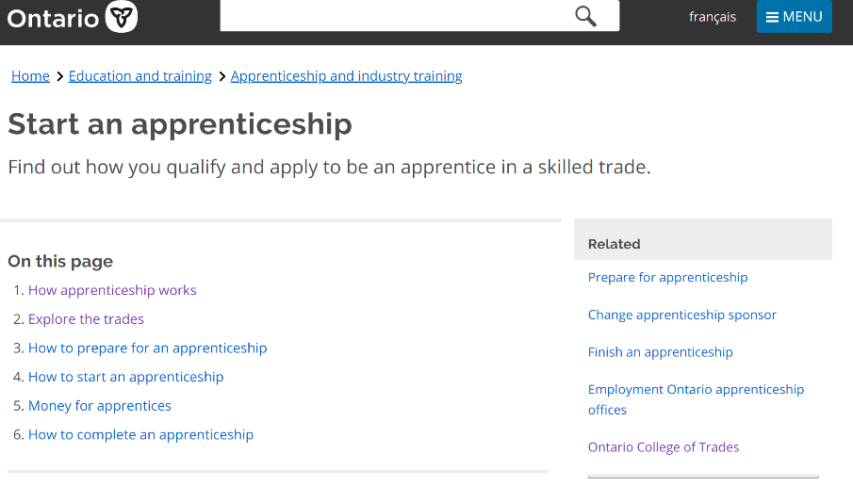
Source: https://www.ontario.ca/page/start-apprenticeship#section-1
Notes:
Back to another screenshot of the same website. This is at the beginning of the Ministry’s website. There is some very good information about starting an apprenticeship.
There is a question in the chat, which raises a good point, i.e., that there is more than one way to get into an apprenticeship. I’m going to hold that thought for a minute, because I’m going to talk about routes into apprenticeship, and then we’ll come back to the question.
This page, “Start an apprenticeship” is a screenshot from the same website that I showed you earlier. As you can see, when you look at the items on the page, it has some very good, plain language information regarding apprenticeship in Ontario and how you can become involved or learn more about it.

Slide 20
How long does it take to complete an apprenticeship?
Apprenticeship programs can range in length from about two to five years.
They generally require three levels of in-school training:
Level 1 (Basic)
Level 2 (Intermediate)
Level 3 (Advanced)
Apprentices alternate their time between working/learning on the job (90%) and going to in-school training (10%).
Notes:
Another common question is, “how long does it take to complete an apprenticeship?” In general, it’s about two to five years. It’s not unlike a post-secondary diploma or degree given the length of time.
Most apprenticeships have three levels of training: basic, intermediate and advanced. Some trades have only basic and intermediate. If it’s a trade with three levels, it’s going to take a bit longer.
If I were to sign on as an apprentice in January and I have some background in the trade, then I will spend at least most of the first year becoming proficient in what would be the Level 1 on-the-job skills, and then toward the end of the first year, my employer would send me for the Level 1 in-school training. After that, I would start working on the Level 2 skills and so on. At the end of each level, there is an exam. Depending on whether it’s a trade with two levels or three, and depending on how long it takes for your employer to become comfortable with your skill level and how long it takes you to acquire skills, there is no hard and fast time frame. In some cases, if someone comes in with a lot of skills, they may proceed through the on-the-job training faster.
A question from the audience: “so why are the colleges taking people for courses? It defeats the purpose if people have to start as a labourer.”
Response: People don’t have to start as a labourer. Some people do, but they don’t have to. I just used that as an example. Let’s say I got a job in an entry-level position in a machine shop, I might decide that I would like to get involved in the trade and then proceed to an apprenticeship with that employer. It might not have been my intention originally, but after working for the company, I might decide to pursue an apprenticeship. So in no way do people have to start as a labourer. Lots of people who start apprenticeships have a high level of skill already.

Slide 21
What education do I need to become an apprentice?
An Ontario Grade 12 diploma or equivalent is required for most trades in the industrial, service and motive power sectors.
For entry into most construction sector trades, completion of grade 10 is the minimum requirement BUT..
Most employers are looking for apprentices with grade 12 or equivalent.
Employers are permitted to ask for academic qualifications that are beyond the minimum when they are hiring apprentices.
A strong foundation in math, sciences, and communications is usually important along with problem-solving, critical thinking, communication, teamwork and digital skills.
Notes:
This is an important discussion because many of us online today are educators and are helping people to learn more about what they need academically to become an apprentice. Most trades require a Grade 12 diploma or equivalent including the industrial, service and motive power sectors. At this point, some of the construction sector trades require complete of Grade 10 not 12, but there is a really big “but” here: most employers want their apprentices to have Grade 12 or equivalent. Even though technically one could register as an apprentice with Grade 10, in reality most employers want Grade 12 or equivalent, no matter what the trade.
Another important point is the fourth bullet. Even though Grade 12 might be the stated minimum requirement for education in the legislation around apprenticeship, because employers are hiring you for a job, they can ask for any qualifications they want. For example, some employers may require a one-year college certificate in the trade before hiring as an apprentice where others only require Grade 12. Some might look for a specific course. For example, the union at the International Brotherhood of Electrical Workers often requires students to have a Grade 12 technical math credit, the MCT4C Math for College Technology. In the ACE program at the colleges, we have ACE Technical math which is an equivalent course. Those are just examples of some places where employers require more than the minimum requirement.
There is a comment in the chat that colleges work in tandem with employers – yes!
There is another comment about people taking courses but can’t find employers to take them on: maybe colleges and employers should partner. As this comment points out, colleges have strong relationships with lots of employers, but colleges can’t force employers to hire apprentices. It’s a huge commitment for employers.
At this time, there are ratios of journeypersons to apprentices which sometimes limits employers’ ability to take on more apprentices. For example, if there is a ratio of 2:1 where a journeyperson can train a maximum of two apprentices, if the maximum is met the company can’t take on additional apprentices.
It is my understanding that the provincial government is trying to make it easier for employers to take on apprentices.
To go back to the last bullet on the slide, generally, in order to be successful in an apprenticeship, a good foundation in math and sciences is certainly important. The essential skills that are sometimes overlooked are problem-solving, critical thinking, communication, teamwork and digital skills. The need for digital competency is not exclusive to college and university training. There is lots of digital competency coming into many trades as well.

Slide 22
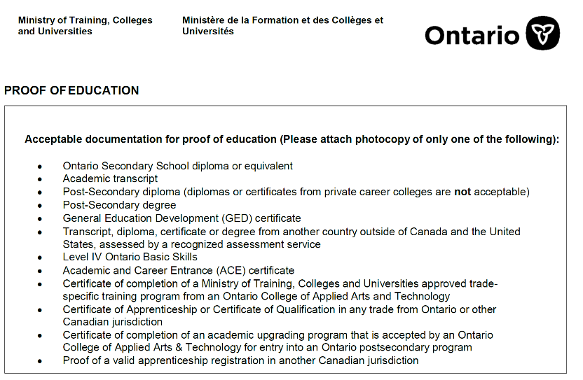
What are acceptable grade 12 equivalent credentials?
Notes:
This is a screenshot of a document that the Ministry currently provides to potential apprentices in order to let them know what are acceptable Grade 12 equivalent credentials. The GED is listed, Level 4 Ontario Basic Skills (the precursor to LBS; years ago we had Ontario Basic Skills – in LBS there is no credential attached so it isn’t listed). There is also the Academic and Career Entrance certificate which is the college Grade 12 equivalent certificate.
If you were already an apprentice and have qualified as a journeyperson, and you want to complete a different apprenticeship, you are qualified to enter.
It also addresses some out-of-province qualifications.
This is the exact document that the Ministry can provide when someone inquires about acceptable Grade 12 equivalent credentials.
Deb says that she didn’t realize there are so many options. That’s true – there are many alternatives that are acceptable to register as an apprentice other than an Ontario secondary school diploma.
I’ll also highlight the sixth bullet: transcript, diploma, certificate or degree from another country outside of Canada and the United States, assessed by a recognized assessment service. In some parts of the province, immigrants come into the country who are qualified in the trade in their own country. If they wish to become an apprentice in Ontario, they can look at getting their credentials translated or assessed by a recognized assessment service. That’s something we may end up seeing more of in the future.

Slide 23
What are the steps to becoming an apprentice?
Step 1:
Research the trades/occupations you’re interested in to learn more about the
types of work and working conditions
job opportunities available in your area
demand for that trade/occupation
education is required
wages
Talking to someone who works in the occupation(s) you’re interested in is a great source of first-hand information!
This Photo by Unknown Author is licensed under CC BY-NC-ND
Notes:
Let’s spend a few minutes looking at the steps to becoming an apprentice. I think we can all agree that the first one is very important. If someone is going to look at getting into apprenticeship, they really need to understand the demands and the work involved in that trade, just like any other profession. Just because it’s a skilled trade, it doesn’t mean that there is more or less research involved.
Talking to someone who works in the occupation is a great source of information. I think that because apprenticeship is somewhat misunderstood, the more that our learners or colleagues can talk to someone who works in the trade or who has been through an apprenticeship, the better that will be.
Just to put in a plug for upcoming webinars, there is one where we do have a journeyperson who will be presenting some information about her trek through the apprenticeship world and getting qualified.
Debera Flynn: We have three journeyworkers who are going to be talking about their pathway through apprenticeship at the next webinar in January.
Barb Glass: Thanks for reminding me of the content of that one.
To return to a question about a student who takes a plumbing course, through Canadore or some other college – would that qualify them without having a Grade 12 diploma or equivalent? Looking back at the previous slide, that question falls under post-secondary diploma, which is what a person would get if they completed a whole college program. Completing one or two courses wouldn’t do it, but if the person graduated and has a diploma or certificate from a post-secondary institution, it would. However, note that private career colleges are not included as an acceptable equivalent.
I find that I hear more and more about students who do go to a college program and take a diploma program in a trade to make themselves more attractive to an employer, because the employer knows that they are already going in with some skills.
A participant points out that plumbing is Grade 10. That’s true, because plumbing is a construction trade, but if the employer wants to require Grade 12, they can. But technically, Grade 10 is acceptable, but it is up to the employer’s discretion.

Slide 24
What are the steps to becoming an apprentice?
Step 2:
Upgrade your skills/education if necessary, to meet the academic requirements.
Step 3:
Search for an employer who will hire you as your ‘sponsor’.
Finding a position as an apprentice is just like any other job search.
Visit your local Employment Services provider to help you find an employer!
This Photo by Unknown Author is licensed under CC BY-SA
This Photo by Unknown Author is licensed under CC BY-SA-NC
Notes:
Steps to becoming an apprentice. Step 2. Once someone has done some research, they might find that they do need to do some upgrading, whether it’s to finish their OSSD, to get an ACE certificate or get their credentials from another country translated. That’s the step where we can help as LBS providers.
Step 3 might be concurrent with Step 2. You might begin your job search while you are still upgrading your education to try to find some leads, talk to some employers, do some informational interviews. Again I stress that finding a position as an apprentice is just like any other job search.
Our employment services providers are very well set up to help potential apprentices look for employers. I would encourage you, if you have learners or colleagues interested in apprenticeship, to refer them to your ES partners. They may be able to provide some leads in the community, or they may be able to provide some information about what isn’t possible in that community but might be more viable in a different community if someone is willing to relocate.

Slide 25
What are the steps to becoming an apprentice?
Step 4:
Apply online on the ministry’s “Start an Apprenticeship” website once you have found an employer that has agreed to hire you.
Step 5:
Sign the legal training agreement with your employer and the ministry.
Step 6:
Start working as an apprentice!
Notes:
Once you have found someone who will hire you and is willing to take you on as an apprentice, there is an online application form on the Ministry’s website – the same website I have been referring to throughout the discussion today – and that leads to Step 5 which is the legal training agreement between the employer, the Ministry and the apprentice. Then you are set to go.
We have a question: Do you find the pre-apprenticeship programs to be helpful to LBS clients? Yes, and we’re going to talk about that in just a moment!

Slide 26
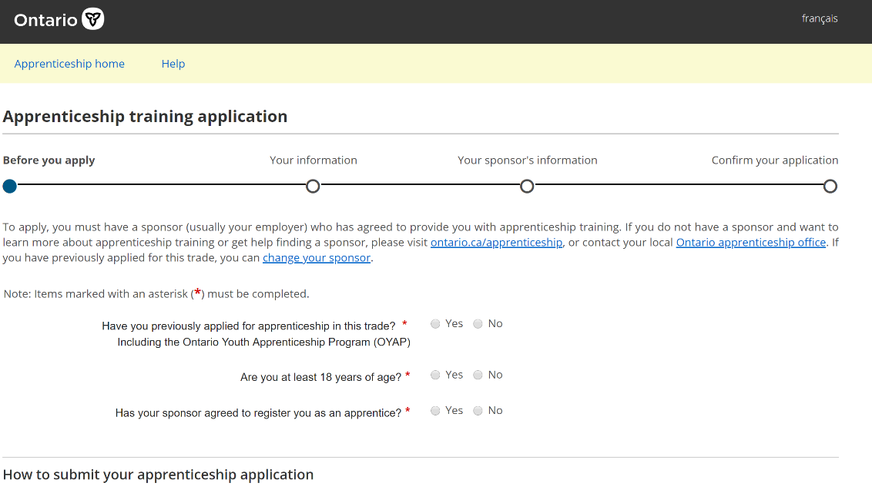
Notes:
This is a screenshot of the apprenticeship training application that is referenced on the previous slide in Step 4. The Ministry did used to use a paper form, but now it’s digitized so people can apply online.
It is possible for an apprentice to change employers partway through the apprenticeship. You can see that one of the options is “change your sponsor”. It’s like any other employer/employee relationship. An employer can decide to terminate an apprentice, or the apprentice can decide to quit and look for another sponsor. That’s ok, you don’t have to stay with the same sponsor from start to finish. Your training follows you if you can find another sponsor and you wish tow change.

Slide 27
What credentials does apprenticeship provide?
– Certificate of Apprenticeship –
issued to an apprentice by the Ontario government for successful completion of all requirements of their training program
– Certificate of Qualification –
issued by the Ontario College of Trades* for successful completion of all apprenticeship training and the trade-specific qualification exam
*subject to change
Notes:
Before we talk about the different routes into apprenticeship, a bit of clarity around what you get out of it credential wise. When you complete all of the levels of training successfully, both on-the-job and in-school training, you get a Certificate of Apprenticeship issued by the Government of Ontario. The Certificate of Qualification (CofQ) is currently issued by the Ontario College of Trades, but a reminder that OCoT will be changing at some point in the future. The CofQ piece is that trade-specific qualification exam. The Certificate of Apprenticeship says you have completed all of the training. The Certificate of Qualification says you have completed the very final trades-specific qualifying exam, which in the restricted trades leads you to becoming a licensed journeyperson.
This is probably somewhat beyond the scope of discussion today, but I think it’s important to be aware of what you come out with when you finish as an apprentice.

Slide 28
Is there any financial help available for apprentices?
Apprenticeship Incentive Grant | Apprenticeship Completion Grant | Apprenticeship Incentive Grant for Women | Canada Apprentice Loan
a taxable cash grant of $1,000 per year or level, for a lifetime maximum amount of $2,000 per person. | a one-time taxable cash grant lifetime amount of $2,000 per person for registered apprentices who complete their apprenticeship training and obtain their journeyperson certification. | a taxable cash grant of $3,000 per year/level up to a maximum amount of $6,000 per person. | a government loan that can help apprentices get the money they need to achieve their goals.
Notes:
Financial help for apprentices – yes! The government is looking at ways there can be financial assistance. Here are a few grants that are available – these are the four that are currently available.
Apprenticeship Incentive Grant: $1000 per year or level, for a lifetime maximum amount of $2000.
The Completion Grant is related to completing the training, so it’s a bit of an incentive for people to complete and obtain their journeyperson certification.
There’s a new Incentive Grant for Women in the Trades.
There is also a Canada Apprentice Loan. Even though one is working when one is an apprentice, it doesn’t mean you might not need a loan. It’s analogous to OSAP but only for apprentices. There is a link on the website that I have been referring to.

Slide 29
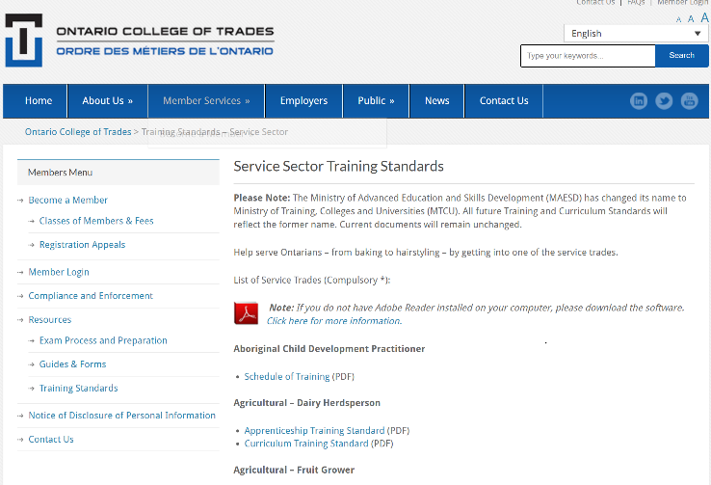
How do I know what I will learn and study?
The Apprenticeship Training Standards, including curriculum/courses, can currently be found on the OCoT website.
On the next slide is the table of contents for the “Baker and Patissier” apprenticeship in-school curriculum.
Notes:
People like to know what they’re getting into before they take on an apprenticeship in terms of what they are going to study. For now, on the Ontario College of Trades, you can find the curriculum and training standards for any of the 143 apprenticeships that we have in Ontario.
On the next slide, I pulled out the Table of Contents for the Baker and Patissier trade for what people learn in the in-school portion.

Slide 30
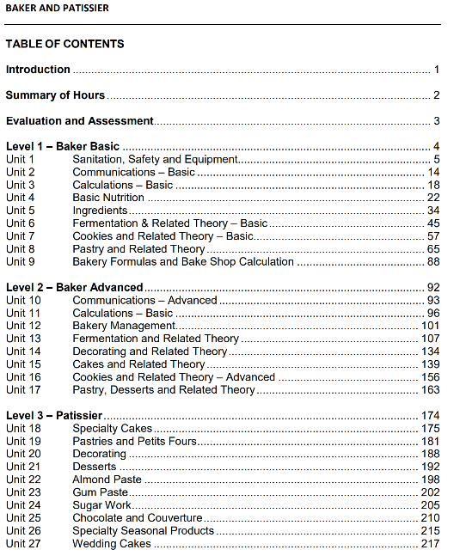
Notes:
This is a screenshot of the Table of Contents page from the document for Baker and Patissier. Each of the units listed under Level 1, 2 and 3 is really a course. It might be anywhere from 15 to 45 hours, depending on the amount of content in the course. I find this interesting in talking to people who might be interested in a trade and who wonder what kind of theory is involved in the in-school training. You can currently go to the OCoT website and source out the training standards for any of the apprenticeships, and you can have a look at some of the content, refer a learner to it, or help a learner find it if they are interested in some of the content of the apprenticeship training.

Slide 31
How does the “in-school” training component work?
The ministry is responsible for
keeping records of apprentices and their training levels completed
purchasing in-school training seats from approved TDA’s
working with the TDA’s across the province to schedule the different levels of training across all the trades/occupations
Notes:
We have a comment that hopefully this information will still be available if the Ontario College of Trades winds down. In the past it was almost impossible to get training standards from the Ministry.
That’s a good point. I certainly hope so too. I do find that information on the OCoT website is pretty easy to find, and it’s pretty comprehensive. I hope it’s just as easy to find once the College of Trades website is no more.
We’ll briefly talk about how the in-school training component works. The Ministry is responsible for keeping records of apprentices and the levels they complete. The Ministry also negotiates with the training delivery agents to purchase the training seats, so if, for example, Mohawk College in Hamilton offers millwright apprenticeships, then they are going to negotiate with the Ministry as to how many seats in the different levels of training that they are going to offer, at what times of the year and how the different levels of training are scheduled.
That’s the Ministry’s side of responsibility right now, because they don’t have the regulatory function that the College of Trades has, but that is subject to change.

Slide 32
How does the “in-school” training component work?
In most apprenticeships, each level of in-school is 240 hrs; some are 360 hrs.
The apprentice pays a classroom fee of about $400 per level.
There are different ways that the in-school training may be scheduled:
block release (you attend full-time, for a set number of weeks, usually 8)
day release (you attend one day per week)
part-time (you attend a night-school program)
alternative delivery (you do online training)
You can normally get Employment Insurance benefits when you are in a ‘block release’ in-school training program.
Notes:
In most apprenticeships, each level of in-school is 240 hours, so generally you go to school the equivalent of 30 hours a week for 8 weeks. Some of the more complex trades might have 360 hours per level.
The apprentice does have to pay a fee of about $400 per level. It’s called a classroom fee.
Here’s something that I find is an interesting concept. In the past, all of the in-school training for many years was delivered on what was called “block release” where you leave your job for 8 to 12 weeks, and you go every day to school instead of going every day to work. But because it can be difficult for employers to release their employees for that length of time, some years ago the in-school training started to be offered in other formats that was a bit easier for both the employers and the apprentices to manage. So “day release” is a concept where you might work 4 days a week and go to in-school on the fifth day. Part-time evening in school as opposed to day-time or even online. That’s a place where Ontario has already modernized apprenticeship to some extent.
If you are an apprentice and you are on block release, you can qualify for EI. Some employers might even top off the EI.

Slide 33
Routes to Apprenticeship: What are they?
What | How | When
Traditional or Direct Route | Find an employer who will hire and sponsor you Sign a Contract of Apprenticeship and receive a Training Standards book Pay a classroom fee (approx. $400) fee and the apprenticeship training period officially begins | Available year-round, whenever an employer and a candidate agree to sign an apprenticeship contract In-school training subsequently scheduled
Pre-apprenticeship programs provide training to prepare for an apprenticeship | Upgrade your academic skills if you do not have the academic requirement (grade level) Complete your Level 1 in-school training and a work placement | May start at any point during the year, pending funding approvals
Notes:
Going back to some of the questions that people asked earlier, there are a number of routes into apprenticeship. Today, we’ve mostly been talking about the traditional direct route where you find an employer, sign the contract, pay your classroom fee and off you go.
We had a question about pre-apprentice. These programs started being funded by the Ontario government in 2000/1. They have been in existence for a long time. They are programs for which interested educational institutions have to apply every year – they are not standing programs. So for the past 20 years, the Ministry has allocated a certain portion of money to funding pre-apprenticeship programs. Most of them have an upgrading component in them for those who don’t have their Grade 12. That’s not across the board – some pre-apprenticeship programs do require apprentices to come in with Grade 12 already. The big advantage of pre-apprenticeship programs is that the Level 1 in-school training is included in most pre-apprenticeships. I’m not going to say all, because some pre-apprenticeships are set up as more of a trade sampler, where a student does a bit of plumbing, a bit of electrical and a bit of welding, so three related trades. In that case, they wouldn’t do the whole level as in-school as part of pre-apprenticeship, but in most pre-apprenticeships they do the Level 1 in-school as part of the training. The very big seller is that there is a work placement attached to a pre-apprenticeship, and the hope is that the work placement will turn into employers signing those pre-apprentices as apprentices. Hopefully that addresses the question. I have managed pre-apprenticeship programs for many years at three different colleges, and I have found it to be a really good introduction for people interested in a particular trade. They aren’t very big, spots are often limited to 15 or 20 because it’s usually limited by how many people can be in the shop at the same time or how many work placements are available in the community.

Slide 34
Routes to Apprenticeship: What are they?
What | How | When
College Full Time or Part Time Programs provide theoretical and hands-on training in the skilled trades | After graduation, market yourself to employers willing to hire you as an apprentice Apply to the college program via OCAS | Generally start in September, January or May
Co-op Diploma Apprenticeship Program (CODA) combines a college diploma program and apprenticeship training | Complete both diploma courses and apprenticeship in-school training in a related occupation Must meet all eligibility criteria for both the college diploma program and the apprenticeship training Apply to the program via OCAS Complete remaining on-the-job training upon graduation in order to qualify for journeyperson status | Generally start in September, January or May
Notes:
We talked a bit about college full time or part time programs. Colleges offer certificate and diploma programs in many skilled trades. Some people opt to do that and then decide they would like to look for a job as an apprentice and move to the apprenticeship program. I think that’s where some of the confusion comes in. Let’s say that you want to apply to George Brown College to do a two-year welding program. That’s not the same as applying for an apprenticeship. I think over the years some people have thought they are applying to get an apprenticeship, when in fact they’re not – they’re applying to a college for a certificate or a diploma program, although that may lead them to an apprenticeship if they choose.
We have a comment that it can be difficult to find where and what programs are offered. I would totally agree in terms of pre-apprenticeship. As someone who has managed them, there isn’t a lot of lead time. Once you get approval from the Ministry to start running a program, there is often about 6 to 8 weeks of marketing and recruitment time before the program starts. Getting the word out can be a considerable challenge. It would be wonderful it it were a standing program, and College X could say here’s what we have for pre-apprenticeship for the next two years, but unfortunately it doesn’t work that way right now. So I agree, it is hard to find what is available where. It isn’t only colleges. Other training providers are approved to provide pre-apprenticeships as well.
We have another comment: “The pre-apprenticeship is where most of my candidates were coming from. Most do not even know if they would like to continue in the field they were in college for.” Many people who come into pre-apprenticeships don’t have any background in the trade. They may have an interest, but not a background. I think that’s a good point, that not everyone who went through a pre-apprenticeship ends up working in the trade. Many people may end up NOT wanting to work there, which is unfortunate, but it’s a good piece of information to have if you have spent years thinking you wanted to be a carpenter, but then after doing a pre-apprenticeship you decide carpentry isn’t for you.
To return to the slide, the CODA or Co-op Diploma Apprenticeship Program is a combination of a college diploma and an apprenticeship at the same time. One has to meet the requirements for both the college diploma and to register as an apprentice. It gives a dual credential at the end: a diploma for the college and the apprenticeship certification as well.

Slide 35
Routes to Apprenticeship: What are they?
What | How | When
Union or Industry Approved Training is available through some unions and trade associations | Must be sponsored (hired) by a union and sign the Contract of Apprenticeship with a Local Apprenticeship Committee (LAC) | May take place at various times of the year
Ontario Youth Apprenticeship Program (OYAP) | Be a full-time high school student entering Grade 11 and at least 16 yrs Work towards a career in the while completing high school diploma and receiving credit for skills gained with an employer | During the high school academic year
Notes:
Another way is going through a trade union or another industry-approved trainer. The union is the sponsor / hiring agent in the agreement. There is still the same contract of apprenticeship but instead of it being with a plumbing company or a car dealership, you are hired by the union. In that case, the union provides most of the training.
Finally there is the OYAP, the Ontario Youth Apprenticeship Program, that is available to students in Grade 11 or 12 who may be interested in working towards an apprenticeship.
Just a note that before you leave, please complete the webinar evaluation! The link has been posted in the chat. Your input really helps us as we develop future webinars.

Slide 36
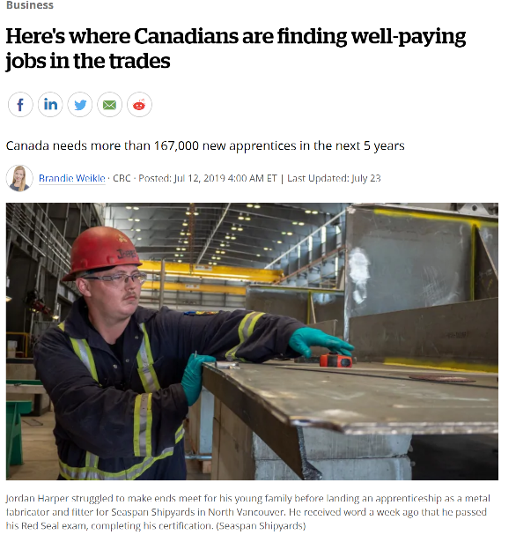
“According to a recent report put together by Statistics Canada and the Canadian Apprenticeship Forum, Canada needs to attract 167,739 new apprentices over the next five years just to keep pace with current demand.”
“In the first quarter for 2019, there were 60,170 job vacancies in Red Seal trades, an increase of 14 per cent from a year earlier, according to Statistics Canada's job vacancy and wage survey. ”
“Looking at hourly earnings in 2018 among certified tradespeople and apprentices still working on their certifications, rig technicians averaged $38.90, boilermakers $38, steamfitters/pipefitters $35.10, ironworkers $33.50 and agricultural equipment technicians $33, according to LMIC calculations based on data from Statistics Canada's labour force survey. ”
Source: https://www.cbc.ca/news/business/canadian-tradespeople-1.5198394
Notes:
I’m going to close with an article that is fairly recent – it came out in the summer. It is from CBC Business News. The link is at the bottom of the slide. It has some stats around job prospects in apprenticeship. The Canadian Apprenticeship Forum says that Canada needs to attract over 167,000 new apprentices over the next five years. In the first quarter for 2019, there were 60,170 job vacancies in Red Seal trades, which is an increase of 14% from the previous year. The last bullet comments about hourly wages. This is a Canadian article, so this doesn’t mean that wages apply across the whole country in every trade, but when you’re looking at hourly rates of close to $40/hour, that’s a pretty fair wage.
The article is quite good. It’s much longer than those few quotes.

Slide 37
Resources
Apprenticeship Training Standards (currently hosted by Ontario College of Trades)
http://www.collegeoftrades.ca/training-standards
Canadian Apprenticeship Forum
http://caf-fca.org/
Earn While You Learn (currently hosted by Ontario College of Trades)
http://www.earnwhileyoulearn.ca/
Financial Assistance for Apprentices (Government of Canada)
https://www.canada.ca/en/employment-socialdevelopment/services/apprentices/grants.html
Here’s Where Canadians are Finding Well-Paying Jobs in the Trades (CBC Business News)
https://www.cbc.ca/news/business/canadian-tradespeople-1.5198394
Knowledge of and Interest in Apprenticeships Among Hamilton’s Literacy and Basic Skills Learners (McMaster University and Adult Basic Education Association)
https://macsphere.mcmaster.ca/bitstream/11375/24561/3/McMaster%20Research%20Shop%20Report%20-%20Adult%20Basic%20Education%20Association%20Hamilton.pdf
Red Seal Trades (Canadian Council of Directors of Apprenticeship)
http://www.red-seal.ca/
Skilled Trades in Ontario (Ministry of Labour, Training and Skills Development)
https://www.ontario.ca/page/list-skilled-trades-ontario
Starting an Apprenticeship (Ministry of Labour, Training and Skills Development)
https://www.ontario.ca/page/start-apprenticeship
Trades at Concert Venues – Video (currently hosted by Ontario College of Trades)
http://www.earnwhileyoulearn.ca/tunein
Notes:
These are some of the resources that I have mentioned or referred to throughout the webinar. Our final webinar in the apprenticeship series is about resources for apprenticeship, so this list is not exhaustive, but it is some of the ones that I used to compile information for today.
I’m going to digress for a moment. An interesting thing crossed my desk this morning. It’s an article that appeared in the Daily Commercial News, which is a construction sector publication. The headline of the article is, “New Research into Millennials Will Inform Skilled Trade Policy Recruitment in Ontario”. Our new Minister, Monte McNaughton, who is the Minister of Labour, Training and Skills Development, provided a speech at the Building Show in Toronto the day before yesterday. I’m going to read you a couple of his comments. I think it’s important for us as LBS providers to take note. He’s referring to millennials and young people, and we know that in LBS we’re getting many more people in the 19-34 age range, many of whom would be considered millennials.
“Many are not even aware what constitutes a skilled trade”, McNaughton said, relaying one anecdote in which a young person said, “it’s easy to become a doctor – everyone knows what to do – but they don’t know how to become a construction worker.”
McNaughton told the delegates that of the 200,000 unfilled jobs reported in Ontario recently, 13,000 were in the construction sector alone. He is also quoted as saying that we need to make it easier to be an apprentice.
If you’re interested in reading the full article, here is the link: https://canada.constructconnect.com/dcn/news/government/2019/12/new-research-into-millennials-will-inform-skilled-trade-recruitment-policy-in-Ontario

Slide 38
Important Meaningful Work the World Can See
Notes:
I will leave you with the concept that apprenticeship really is important and meaningful work that the world can see. I think that it’s wonderful for us to have a chance to talk about it. You have raised some excellent questions.
I will now invite any other questions or comments.

Slide 39
Thank you!
Coming soon:
webinar resources: https://e-channel.ca/practitioners/pop-pd-resources
webinar evaluation:
https://surveys.oalcf-echannel-repository.ca/s3/Pop-UP-PD-Web-4-19-20
registration link for our next webinar:
https://connect.contactnorth.ca/pop_up_5/event/registration.html
Notes:
Debera Flynn: Thank you very much, Barb. We will continue to take questions. As we told you earlier, the next webinar is at the end of January. It will be with three journeypersons from Bruce Power who will talk about their pathway into apprenticeship. The last webinar for the year will be on resources. We have a survey out to the field asking you for your favourite resources so we can collect all of the information to present in the February webinar.
Barb, I learned a couple of things today that I didn’t know, and I will definitely share that information with the programs in my area about what potential apprentices need to enter an apprenticeship. Thank you for sharing all of this information.
We do have a question: How do we know which courses to take for the 10% school requirements? Every apprenticeship course is aligned with Levels. Your ETC that you work with as an apprentice will tell you and your employer when those courses will be available and where.
Barb Glass: The Ministry and the employer work together to schedule the apprentices into the in-school training. The apprentice doesn’t have to go out and find the in-school training. That is part of the apprenticeship contract, so the employer and the Ministry negotiate as to when the apprentice will be released to attend the in-school training.
The analogy would be that if you applied to a college or university program, you might be able to choose a few electives, but in general, the program you have applied to prescribes the courses you are going to take, and it’s the same with apprenticeship. Levels 1, 2 and 3 have prescribed courses – there is no variation from them – so when it comes time for the in-school training, that’s the curriculum that the trainer will follow.
Debera Flynn: We could also affirm that yes, a potential apprentice needs to find their own employer / sponsor.
Barb Glass: At the end of the evaluation, you can put in your name to be entered into a draw for a $25 gift card.
Going back to the chat, the process is that you find an employer, and then there are certain prescribed courses that must be taken. The courses that you take in the in-school training are non-negotiable. Every training provider must follow that set of training standards. I think there is a mistaken impression that apprenticeship is only about working on the job, but the in-school theory component is quite indepth, especially in some of the more complex trades like electrician. A strong academic background is important including reading skills, test-taking skills and some of the more soft skills around education that we don’t really associate with apprenticeship.
There is no list of educational requirements for each trade, but right now, in the industrial sector, the motive power sector and the service sector, the minimum requirement is Grade 12. In the construction sector, on paper, the minimum requirement is Grade 10 but most employers aren’t interested in hiring an apprentice with just Grade 10. Again, employers can require any specific qualifications just like for any job. For some apprenticeships and for some employers, a generic Grade 12 will be fine, but others might require specific courses, and others may require additional credentials or certifications, because they are hiring an employee.
One thing I would suggest is if you are interested in looking what colleges require for the corollary trade diploma programs – for example, for welding – you could look at the admission requirements, because the theory portion of that college program is going to be similar to the theory portion of the in-school. So if the college requires Grade 12 English, you can probably be sure that a good level of English skills would be required for the apprenticeship as well. There isn’t a place where specific requirements are listed other than what I have mentioned regarding Grade 12 or Grade 10. That goes back to my Step 1 of why it’s really important for prospective apprentices to talk to someone who is already working in the trade and get a feel for what kind of on-the-job skills are required, but also, if they can talk to someone who has been through the in-school training they could provide some suggestions. On the OCoT website you can look up each of the sectors but there is no specific course listing.
I really do hope that the information on the OCoT website remains readily available.
Because the apprentice has a log book, and the employer signs off on the skills as they are achieved, it is true that the employer can backdate that if they are confident in the person’s skills. It does raise the point that hiring an apprentice is a big commitment for an employer. Sometimes an employer likes to get to know the employee first as a labourer before hiring them as an apprentice, but not always.
One of the goals of pre-apprenticeship is that the person will have completed the Level 1 in-school training, and after an 8 week work placement, the employer has seen the skills of the person and hopefully will sign them on so both the employer and the apprentice will have a leg up because that first level of in-school is done, and the person has already had some exposure to the trade within the pre-apprenticeship program.
I appreciate the time everyone has taken today. It has been an interesting discussion with some fabulous questions. I thank you for your time and attention. Thank you, Deb, for facilitating and to Sarah for supporting the technology in the background.
Debera Flynn: Thank you, Barb!
Sarah Stocker: Thank you to Barb and to Debera and to all of our participants.

